Slide 1
Heaven and Hell!
By:Voorhees.INC
(Shoot,2D)
By Hayoung Cho and Karanbir Bains

Slide 2

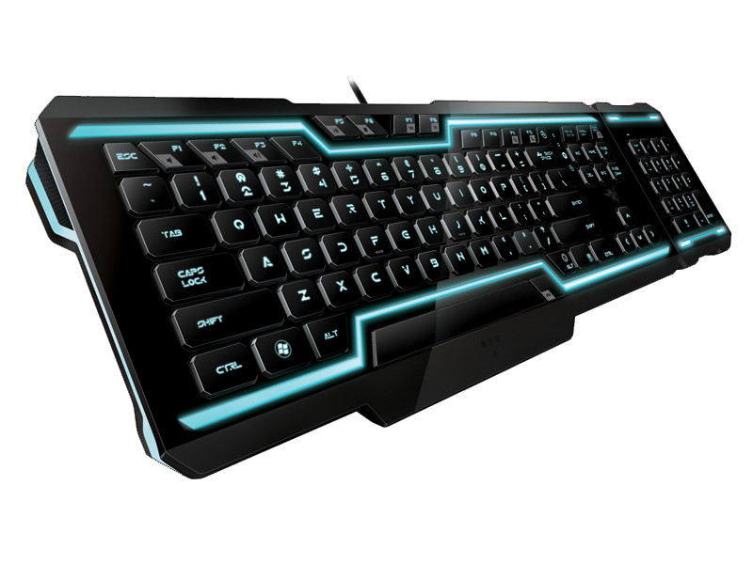
How to Play
Move with Mouse and Shoot with Mouse_LeftButton
Press number 1-9 to upgrade your Abilities.

Slide 3
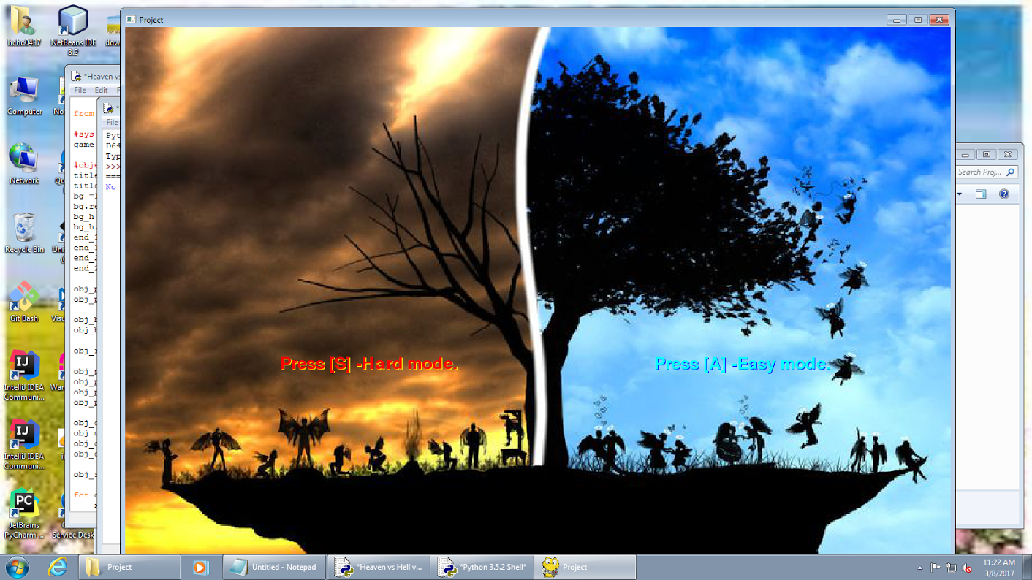
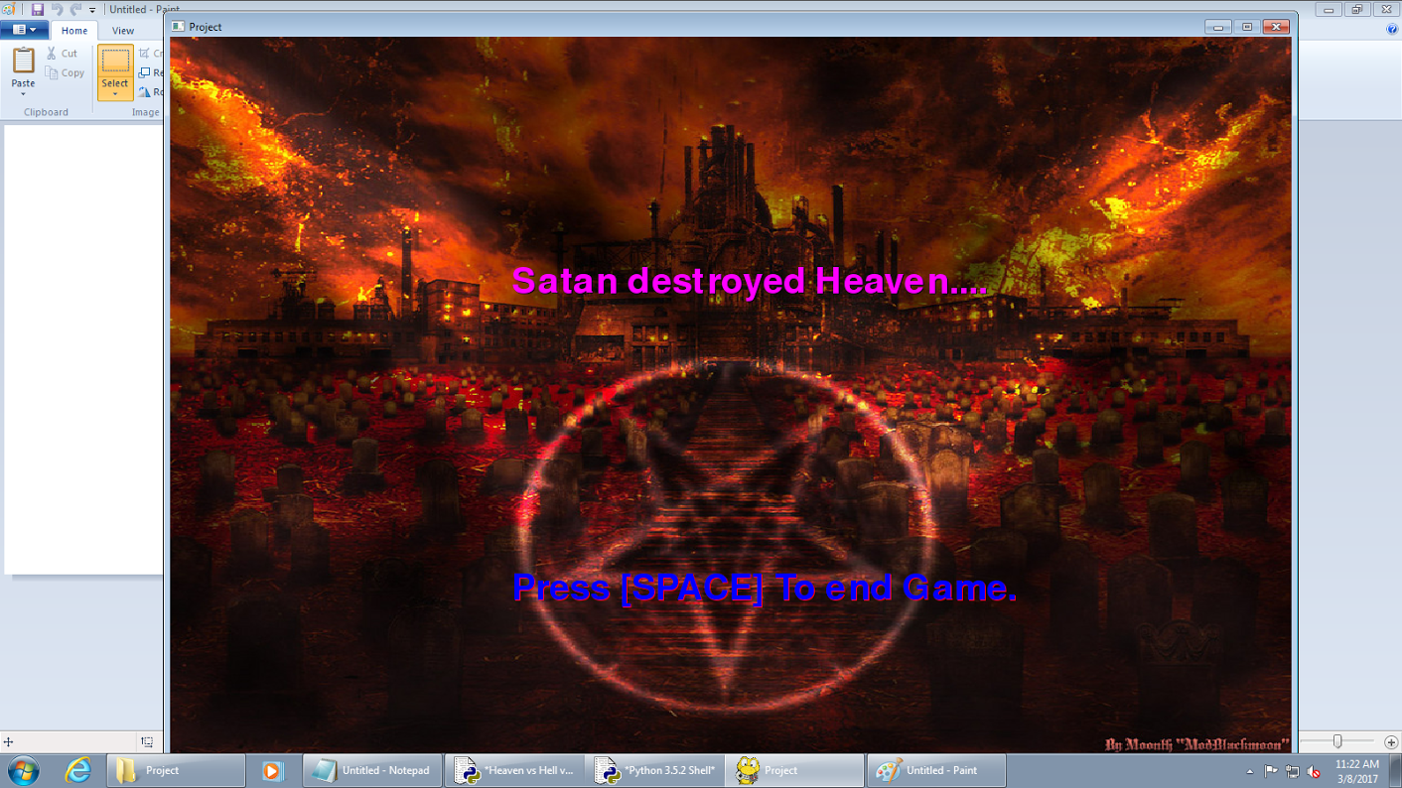

Slide 4
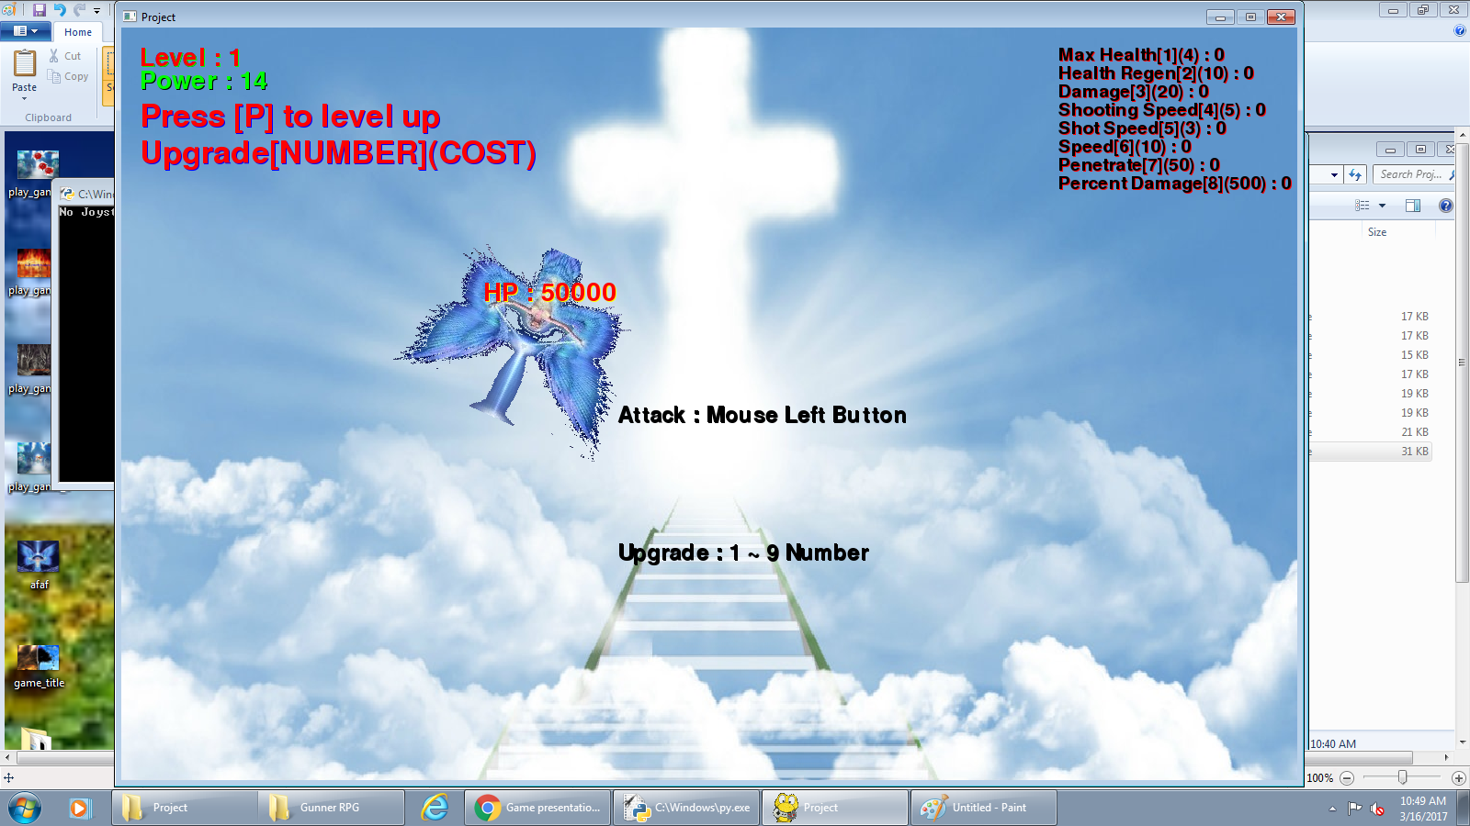
GamePlay

Slide 5
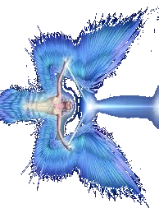


How To Win
If you kill the Boss at level 20.

Slide 6

How to Lose
You lose if all HP is drained.

